Slide 1
Installation Guide to NXP GUI
McMaster Automotive Resource Centre (MARC)
Notes:
HVBMS NXP Tutorials can be found for download from: https://mcmasteru365.sharepoint.com/:u:/r/sites/BatteryWorkforceChallenge-StudentsandManagers-SW2BMSSoftware/Shared%20Documents/SW2%20BMS%20Software/Resources/Archived%20Tutorials/Setting%20Up%20NXP/Tutorial%20-%20HVBMS%20NXP%201.zip?csf=1&web=1&e=RvlWkP This presentation is completed based on “Step 1 - Model_Based_Design_Toolbox_S32K3xx_Series_Quick_Start_Guide.pdf” file, which can be found from Tutorial - HVBMS NXP 1 > S32K - Model Based Design ToolBox after downloading the above .zip file.

Slide 2
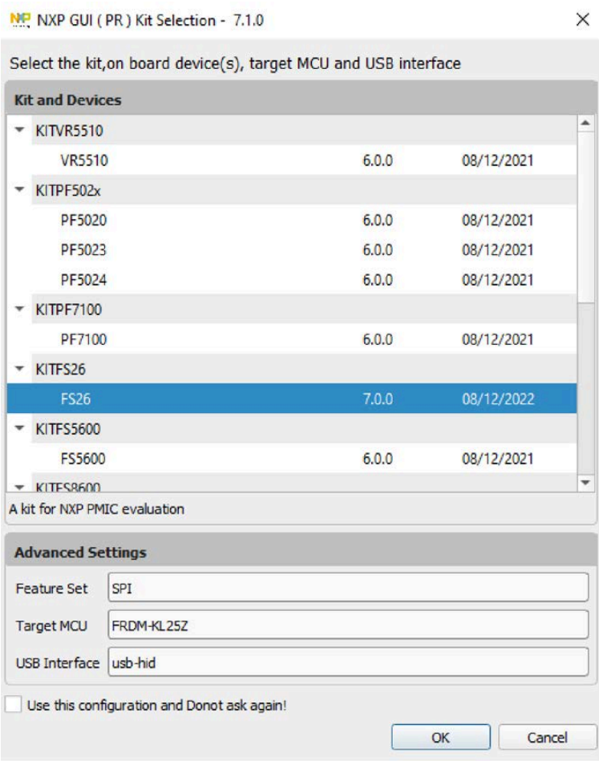
Installation Guide to NXP GUI
Introduction to the NXP PMIC GUI
This is the graphical user interface (GUI) for NXP's Automotive PMIC (Power Management Integrated Circuit) products.
It enables users to evaluate the functionality of PMIC devices, configure the OTP (One-Time Programmable) settings, program the OTP and calculate the thermal efficiency for specific use cases.
Devices Supported: VR5510, FS26, FS86, PF7100, PF502x, PF5020, PF5023, FS5600, PF5024, PF8200, PF8100, PF8201, PF8101 and PF8121 PMICs.
¹OTP memory in PMICs is used to store configuration settings that define how the device behaves. These settings can include voltage levels, current limits, sequencing rules, and other power management parameters. Once programmed, the data in OTP memory cannot be changed. This ensures that the PMIC operates consistently and securely according to the intended design.
NXP GUI for FS26 Automotive PMIC family chosen from the Kit selection window.
Notes:
Download the user manual pdf from https://www.nxp.com/webapp/Download?colCode=UM11812

Slide 3

Installation Guide to NXP GUI
System Requirements
Evaluation Kit (socket or solder down)
KL25Z FRDM Board
Power Supply(0-6V), Power Cable and USB cable
Supported Interface MCUs
KL25Z
K82F
Notes:
Download the user manual pdf from: https://www.nxp.com/webapp/Download?colCode=UM11812
Watch the introductory tutorial titled “NXP GUI Tutorial: How to Program a Blank PMIC Device“ from https://www.nxp.com/design/design-center/software/analog-expert-software-and-tools/nxp-gui-for-automotive-pmic-families:PMIC-GUI-SW?tid=vanPMIC-GUI-SW] to get familiar with the GUI After installation is completed, take your socket EVB. With the blank device you want to program, connect it to a power supply and to your laptop using KL25Z USB port with the provided USB cable. Launch the NXP PMIC GUI. You will be prompted to select your kit based on the device you are working with, i.e., FS26.
Before we begin programming the device, verify the hardware configuration of the evaluation board. Connect the USB cable to KL25Z USB port. Enable the debug voltage on the EVB, which is required to enter the programming mode. Make sure the boost related jumpers are correctly configured for the FS26 depending on the configuration you intend to program. Ensure that BDDIO (Battery Domain Digital Input/Output) is powered via USB by checking the corresponding jumper on the board. Once all hardware settings are confirmed and align with your configuration, power up the evaluation board. LED lights should light up. The hardware is ready for programming.
In the GUI, click the Start button on the top left corner, to establish a connection between the GUI and the device. You will see the connection state is updated at the bottom of the window. Next, click “Apply Test Mode” button at the top to enter the test mode. We are now ready to begin programming. On the left side of the window, navigate to the PROG tab. This opens the device programming window that contains 2 sections: Device Programming Configuration and Fuse Box Status. Click the Read button in the Fuse Box Status section to check the current fuse flags. If the power is blank, you should see all zeros. To load the configuration, click on Browse in the Device Programming Configuration section. Navigate through your Windows File Explorer, select the desired file and open it. Then, click Program in the Device Programming Configuration section. Once the process is completed, a pop-up window will confirm that programming was successful. Follow the instructions in the pop-up and switch off 8 V debug voltage in the board. The device will automatically power up in debug mode using the newly programmed OTP configuration.
As a final check, restart the device, applying 8V in the debug pin. Enter Test Mode again. Read the fuse box status. This time you will see ones instead of zeros in the Main Fuse Flag and Failsafe Fuse Flag subsections indicating the sectors have been successfully fused with no errors.

Slide 4

Installation Guide to NXP GUI
Supported Devices
Power Management
PMICs and SBCs
12 V, 24 V, and 48 V SBC Solutions
FS23
FS24
FS26
FS5600
FS86
VR5510
Power Management
PMICs and SBCs
5 V PMIC Solutions
PF5020
PF5023
PF5024
PF5030
PF5200
PF53
PF7100
PF81-PF82
PF8101-PF8201
PF8121
Notes:
Download the user manual pdf from: https://www.nxp.com/webapp/Download?colCode=UM11812
Watch the introductory tutorial titled “NXP GUI Tutorial: How to Program a Blank PMIC Device“ from https://www.nxp.com/design/design-center/software/analog-expert-software-and-tools/nxp-gui-for-automotive-pmic-families:PMIC-GUI-SW?tid=vanPMIC-GUI-SW] to get familiar with the GUI

Slide 5
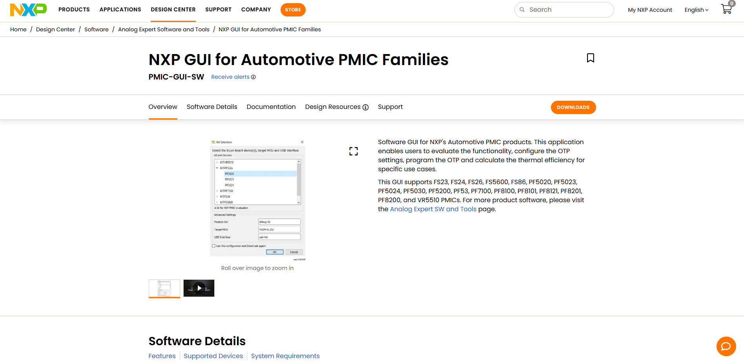
Installation Guide to NXP GUI
Installation Steps: NXP GUI
1. First, go to the Downloads page of the NXP GUI for Automotive PMIC Families. https://www.nxp.com/design/design-center/software/analog-expert-software-and-tools/nxp-gui-for-automotive-pmic-families:PMIC-GUI-SW?tid=vanPMIC-GUI-SW.

Slide 6
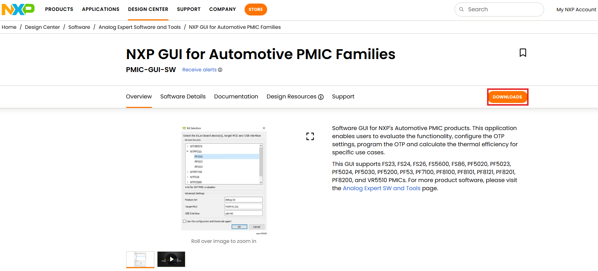
Installation Guide to NXP GUI
Installation Steps: NXP GUI
2. Press Downloads.

Slide 7
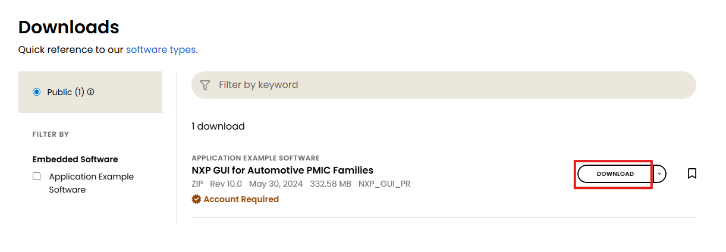
Installation Guide to NXP GUI
Installation Steps: NXP GUI
3. Press Download.

Slide 8
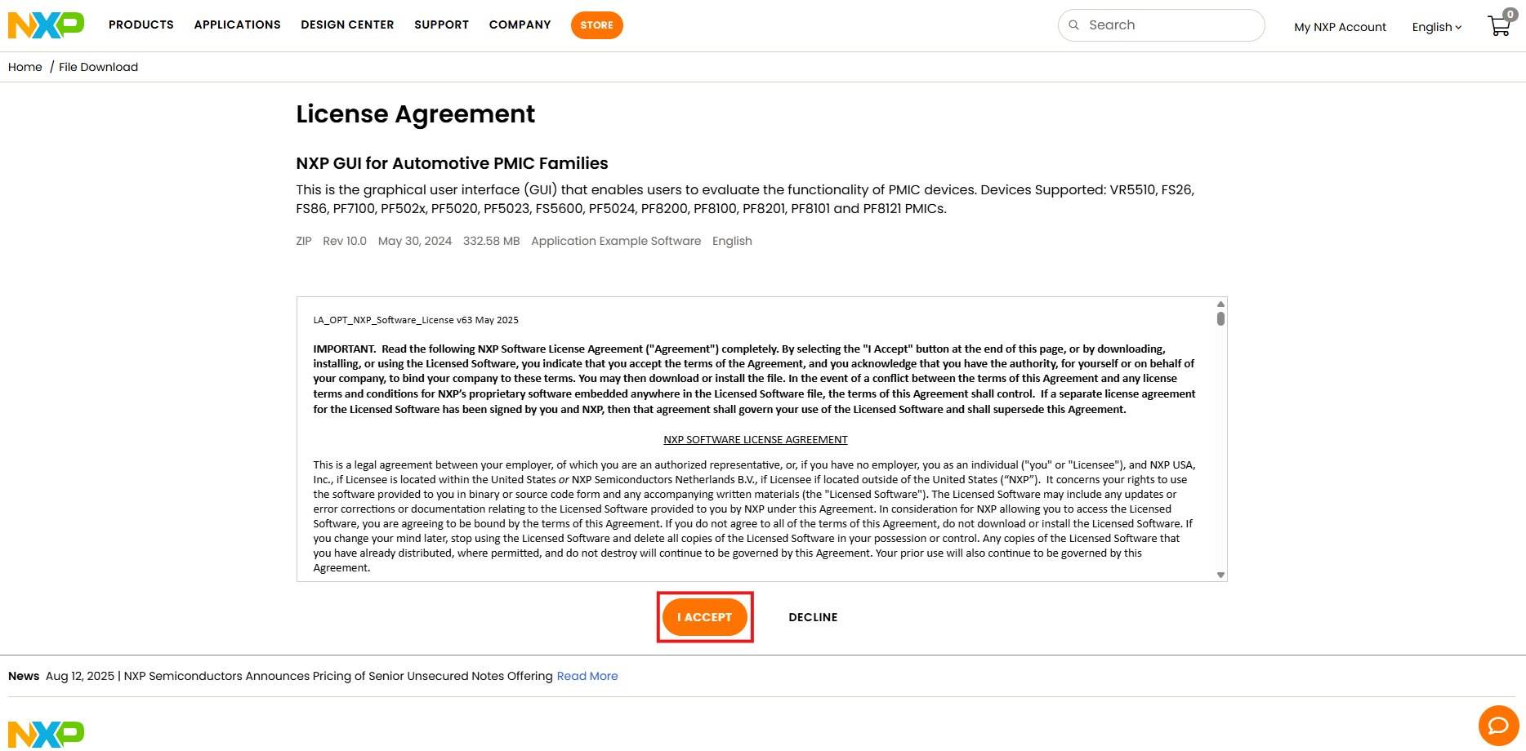
Installation Guide to NXP GUI
Installation Steps: NXP GUI
4. Press I Accept.

Slide 9
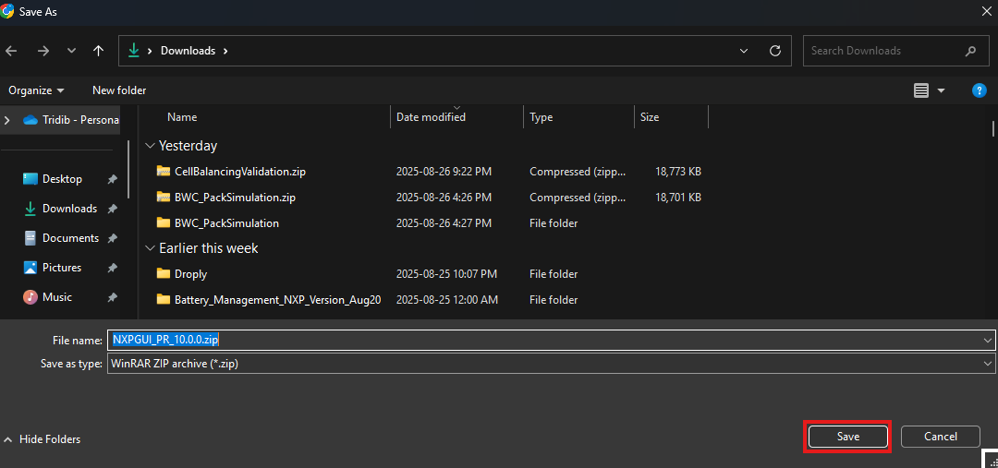
Installation Guide to NXP GUI
Installation Steps: NXP GUI
5. Press Save.

Slide 10
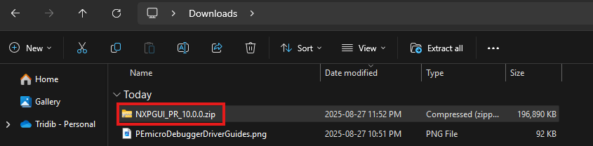
Installation Guide to NXP GUI
Installation Steps: NXP GUI
6. Select the .zip file by pressing once.

Slide 11
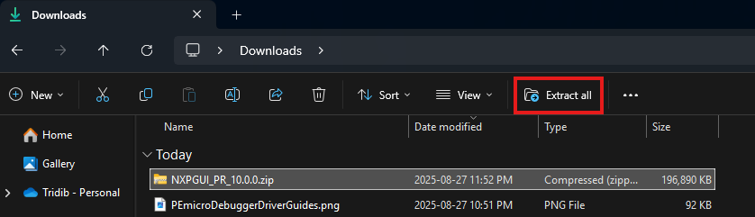
Installation Guide to NXP GUI
Installation Steps: NXP GUI
7. Press Extract all.

Slide 12
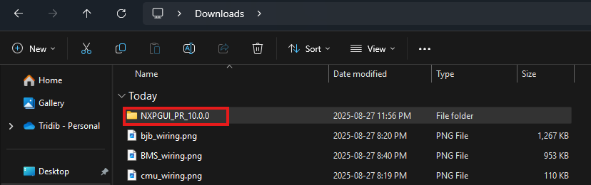
Installation Guide to NXP GUI
Installation Steps: NXP GUI
8. After the extraction is done, a new folder will be created. Go inside it by double-clicking it.

Slide 13
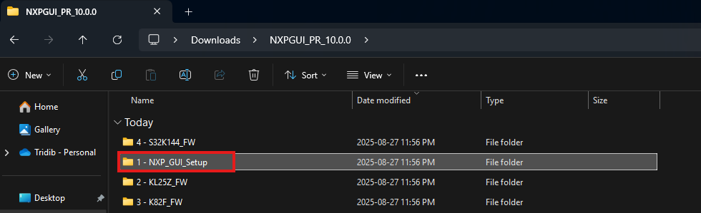
Installation Guide to NXP GUI
Installation Steps: NXP GUI
9. Go inside the folder named 1 - NXP_GUI_Setup by double-clicking it.

Slide 14
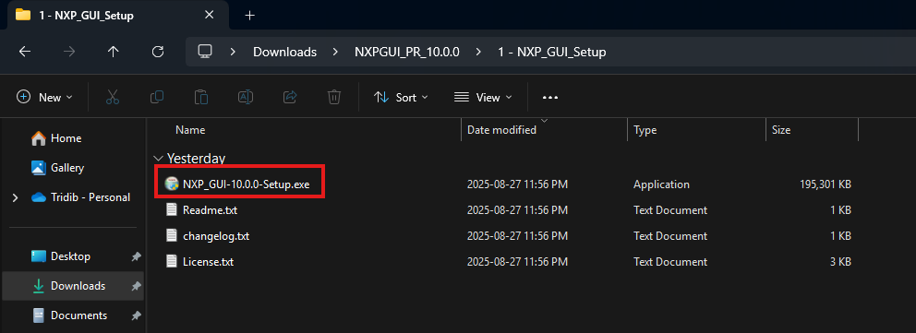
Installation Guide to NXP GUI
Installation Steps: NXP GUI
10. Execute NXP_GUI-10.0.0-Setup.exe by double-clicking it.

Slide 15
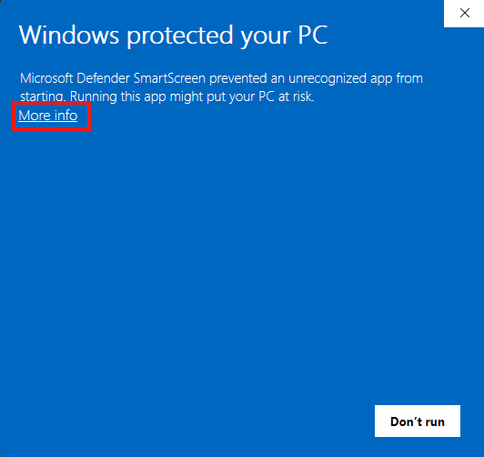
Installation Guide to NXP GUI
Installation Steps: NXP GUI
11. If Windows protected your PC pop-up window shows up, press More info.

Slide 16
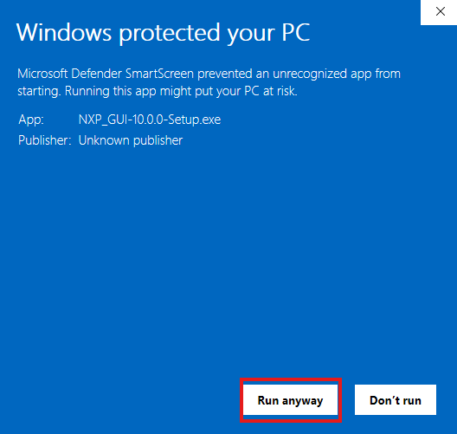
Installation Guide to NXP GUI
Installation Steps: NXP GUI
12. Press Run anyway.

Slide 17
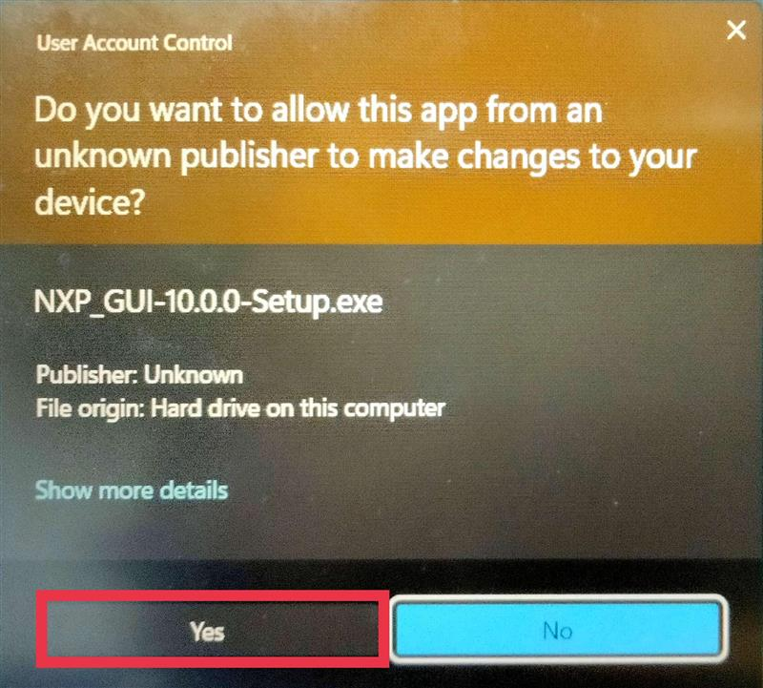
Installation Guide to NXP GUI
Installation Steps: NXP GUI
13. Press Yes.

Slide 18
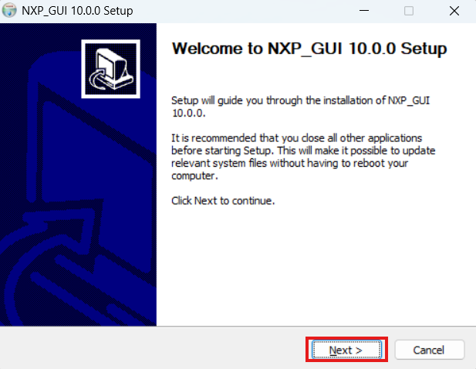
Installation Guide to NXP GUI
Installation Steps: NXP GUI
14. In the NXP_GUI 10.0.0 Setup pop-up window, press Next.

Slide 19
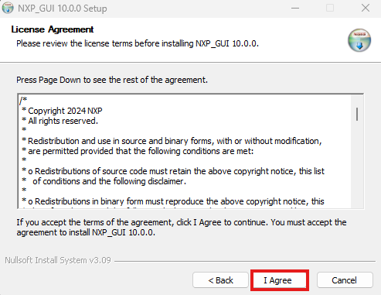
Installation Guide to NXP GUI
Installation Steps: NXP GUI
15. Press I Agree.

Slide 20
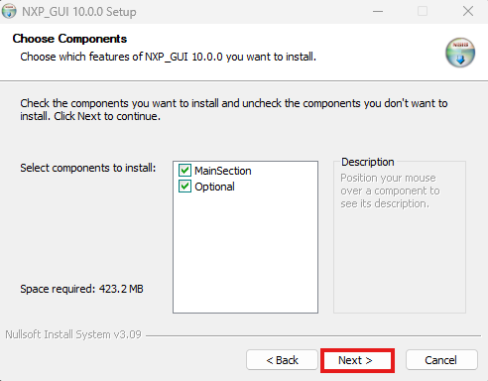
Installation Guide to NXP GUI
Installation Steps: NXP GUI
16. Press Next.

Slide 21
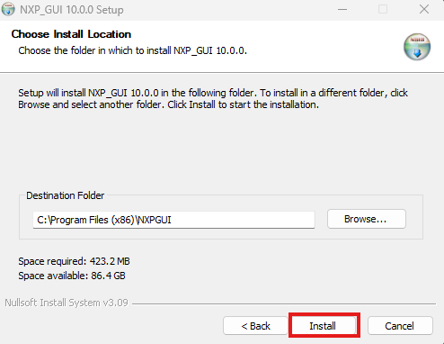
Installation Guide to NXP GUI
Installation Steps: NXP GUI
17. Press Install.

Slide 22
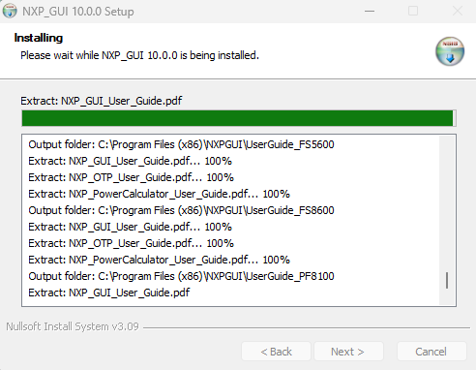
Installation Guide to NXP GUI
Installation Steps: NXP GUI
18. It might take 15-20 minutes to complete all the installations.

Slide 23
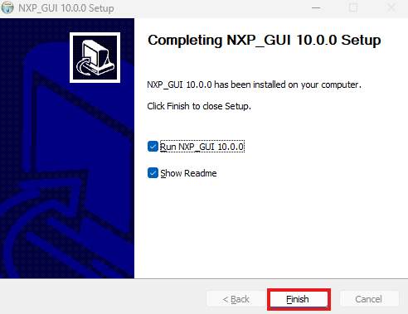
Installation Guide to NXP GUI
Installation Steps: NXP GUI
19. Click Finish once the installation is over.

Slide 24
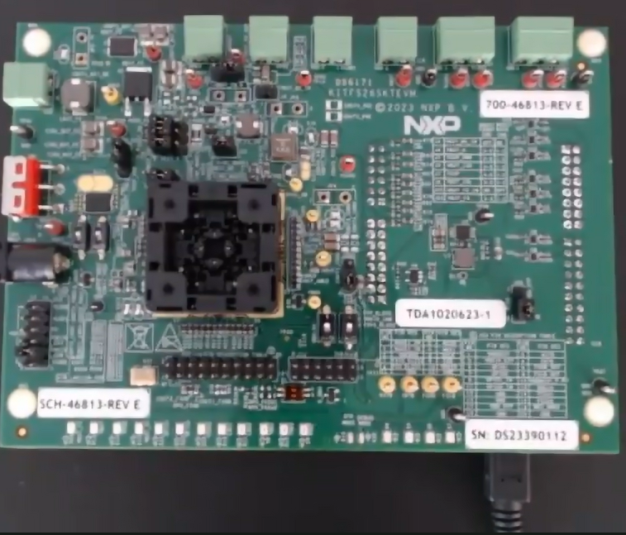
Installation Guide to NXP GUI
NXP GUI Setup
1. After installation is completed, take your socket EVB. With the blank device you want to program, connect it to a power supply and to your laptop using KL25Z USB port with the provided USB cable.

Slide 25
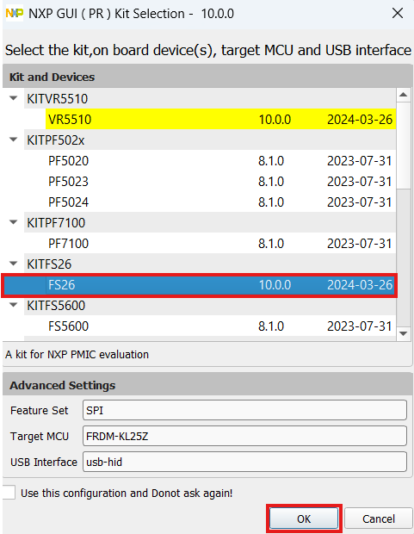
Installation Guide to NXP GUI
NXP GUI Setup
2. You will be prompted to select your kit based on the device you are working with, i.e., FS26. In the NXP GUI ( PR ) Kit Selection window, select FS26 and press OK.

Slide 26
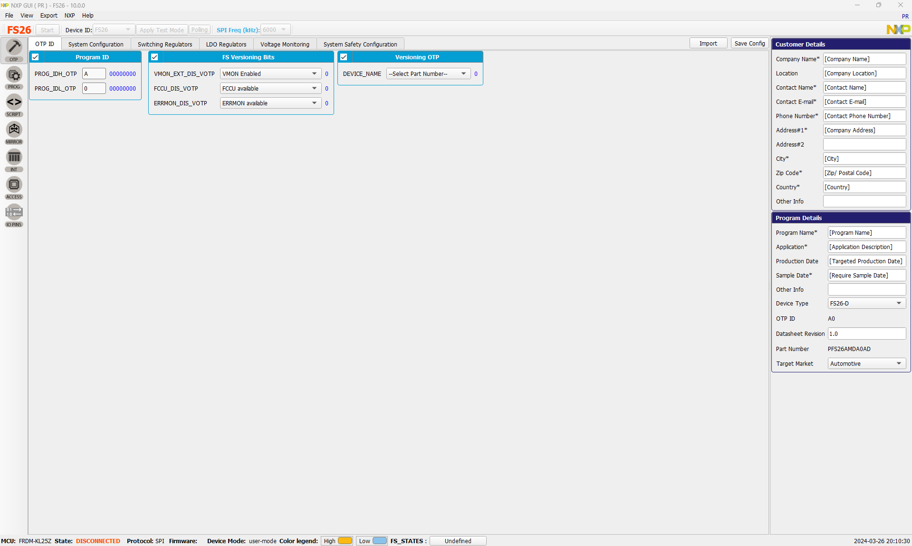
Installation Guide to NXP GUI
NXP GUI main interface after launching the NXP PMIC GUI

Slide 27
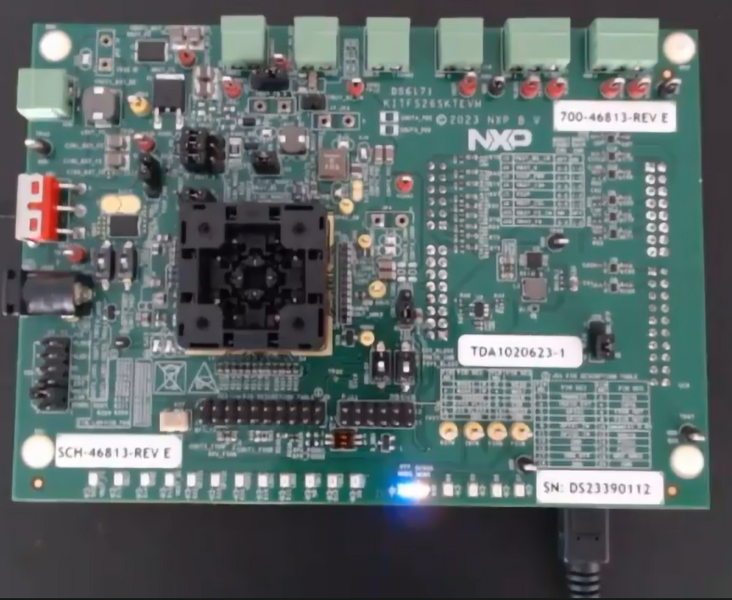
Installation Guide to NXP GUI
NXP GUI main interface after launching the NXP PMIC GUI
3. Before we begin programming the device, verify the hardware configuration of the evaluation board. Connect the USB cable to KL25Z USB port. Enable the 8V debug voltage from the EVB, which is required to enter the programming mode. When blue and long-range LEDs light up, the board is ready for debugging.

Slide 28
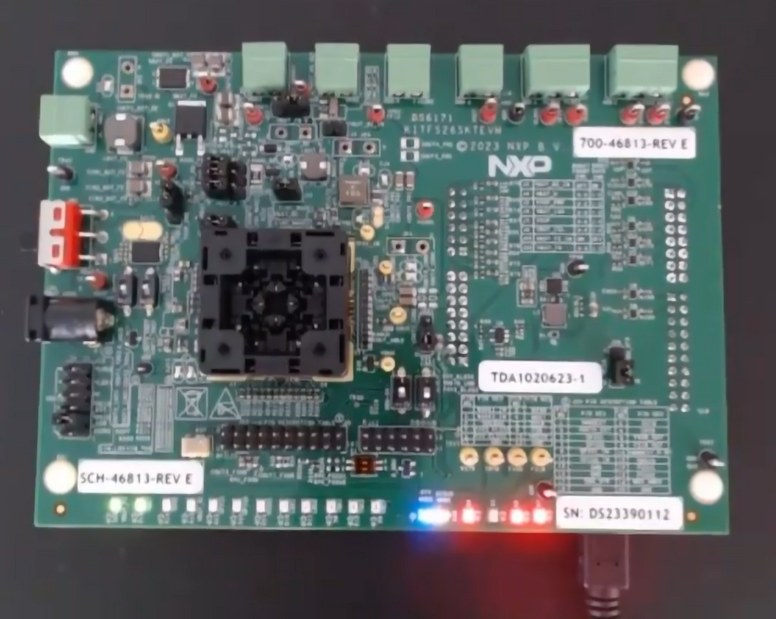
Installation Guide to NXP GUI
NXP GUI Setup
4. Make sure the boost-related jumpers are correctly configured for the FS26, depending on the configuration you intend to program. Ensure that BDDIO (Battery Domain Digital Input/Output) is powered via USB by checking the corresponding jumper on the board. Once all hardware settings are confirmed and aligned with your configuration, power up the evaluation board. LED lights should light up. 3 additional red LEDs (RESETB, FESEROB, safety output) should light up. 2 additional green LEDs should light up: one for battery voltage, and the other for front-end boost. At this point, the hardware is ready for programming.

Slide 29
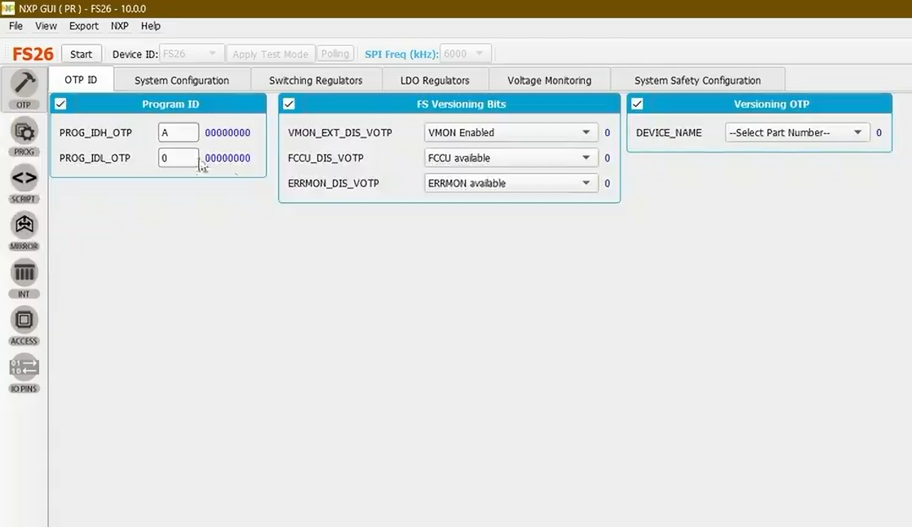
Installation Guide to NXP GUI
NXP GUI Setup
5. In the GUI, click the Start button in the top left corner to establish a connection between the GUI and the device.

Slide 30
Installation Guide to NXP GUI
NXP GUI Setup
6. You will see the connection state is updated at the bottom of the window.

Slide 31
Installation Guide to NXP GUI
NXP GUI Setup
7. Next, click the Apply Test Mode button at the top to enter the test mode. We are now ready to begin programming.

Slide 32
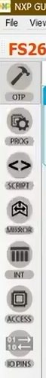
Installation Guide to NXP GUI
NXP GUI Setup
8. On the left side of the window, navigate to the PROG tab.

Slide 33
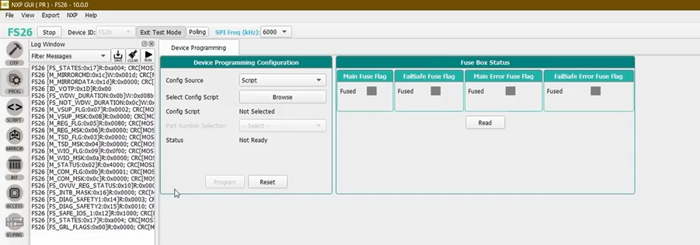
Installation Guide to NXP GUI
NXP GUI Setup
9. PROG tab opens the device programming window that contains 2 sections: Device Programming Configuration and Fuse Box Status. Click the Read button in the Fuse Box Status section to check the current fuse flags.

Slide 34
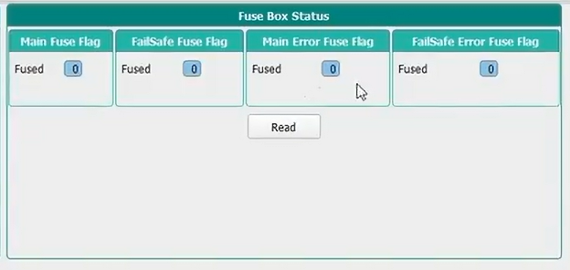
Installation Guide to NXP GUI
NXP GUI Setup
10. If the power is blank, you should see all zeros.

Slide 35
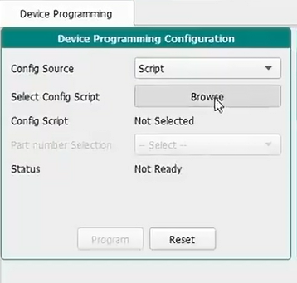
Installation Guide to NXP GUI
11. To load the configuration, click on Browse in the Device Programming Configuration section.

Slide 36
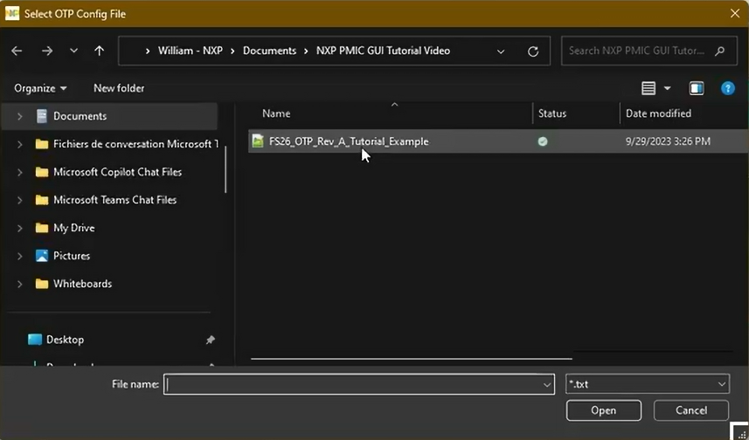
Installation Guide to NXP GUI
12. Navigate through your Windows File Explorer, select the desired file and open it.

Slide 37
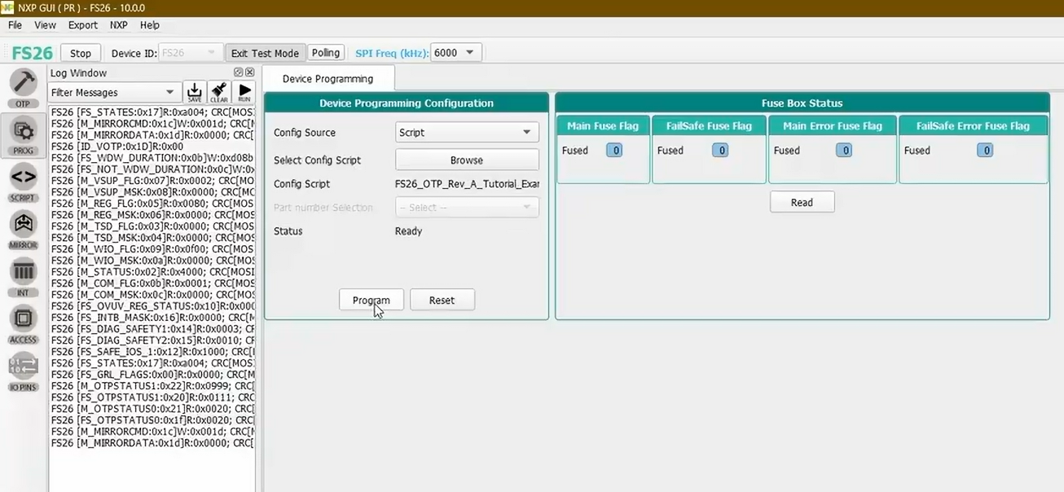
Installation Guide to NXP GUI
13. Then, click Program in the Device Programming Configuration section.

Slide 38
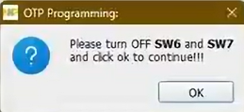
Installation Guide to NXP GUI
14. Once the process is completed, a pop-up window will confirm that programming was successful.

Slide 39
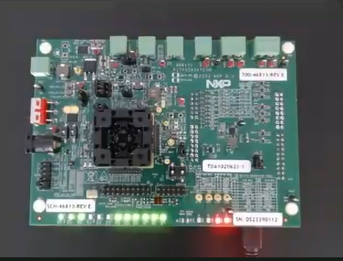
Installation Guide to NXP GUI
15. Follow the instructions in the pop-up and switch off 8V debug voltage in the board. The device will automatically power up in debug mode using the newly programmed OTP configuration.

Slide 40
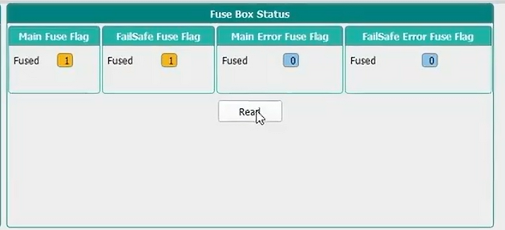
Installation Guide to NXP GUI
16. As a final check, restart the device, applying 8V to the debug pin. Press Apply Test Mode again. Read the Fuse Box Status. This time, you will see ones instead of zeros in the Main Fuse Flag and FailSafe Fuse Flag subsections, indicating that the sectors have been successfully fused with no errors.

Slide 41
Thank you
McMaster Automotive Resource Centre (MARC)
41

